Slide 1

Golden Gate
Home Of The Gators

Slide 2
Philosophy of Middle Years in SJASD
A Middle Years environment is based upon the needs and characteristics of the adolescent learner. These characteristics must be recognized as being developmental and dynamic. Caring, trained professionals will meet the intellectual, physical, social and emotional needs of the middle years student by offering programs reflecting active learning strategies, integrated curricula, exploratory experiences and opportunities to nurture positive relationships with adults and peers.

Slide 3
School Day Schedule
Time​ | Period ​
8:50 am | Student Entry
9:00 am | Warning Bell
9:05 am | Period 1​
9:46 am | Period 2​
10:23 am | Nutrition Break
10:28 am | Period 3
11:07 am | Period 4
11:45 am | Lunch Hour
12:45 pm | Every Gator Reads
1:02 pm | Period 5
1:45 pm | Period 6
2:20 pm | Nutrition Break
2:25 pm | Period 7
3:03 pm | Period 8
3:43 pm | Dismissal

Slide 4

Mandatory Courses
Golden Gate Middle School follows the standards of the Manitoba Education Curriculum Guidelines in all subject areas:
English Language Arts
Mathematics
Sciences
Social Studies
French
Physical Education

Slide 5
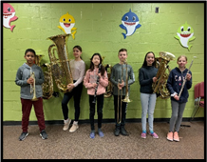
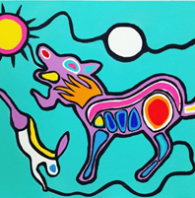
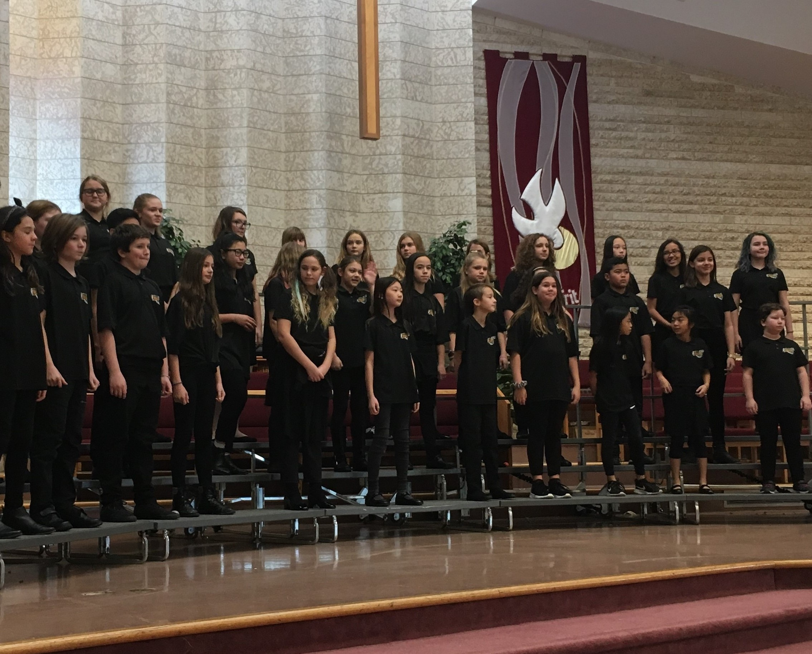
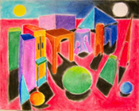
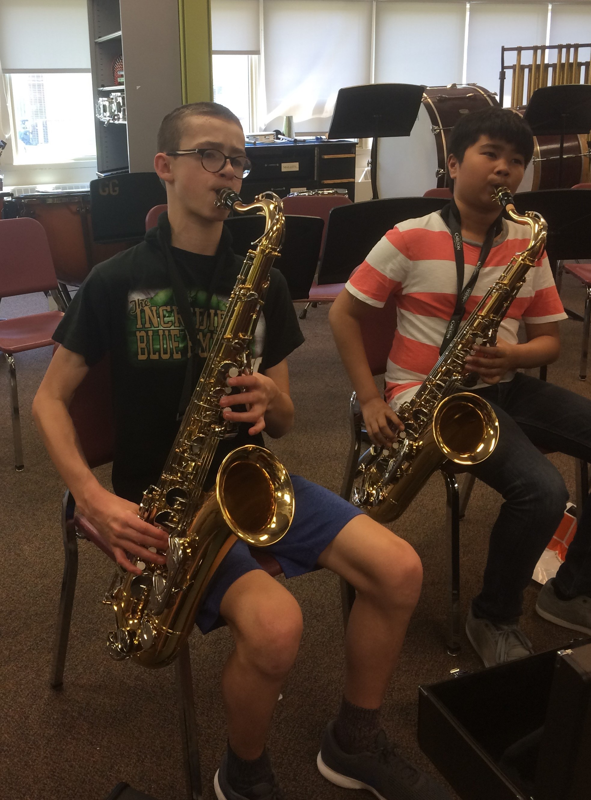
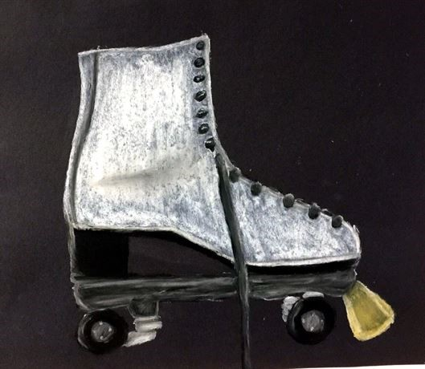
Options
        Students have the choice to take Art OR Band
        Some Additional Options Include:
        Choir
        Jazz Band
        Vocal Jazz

Slide 6
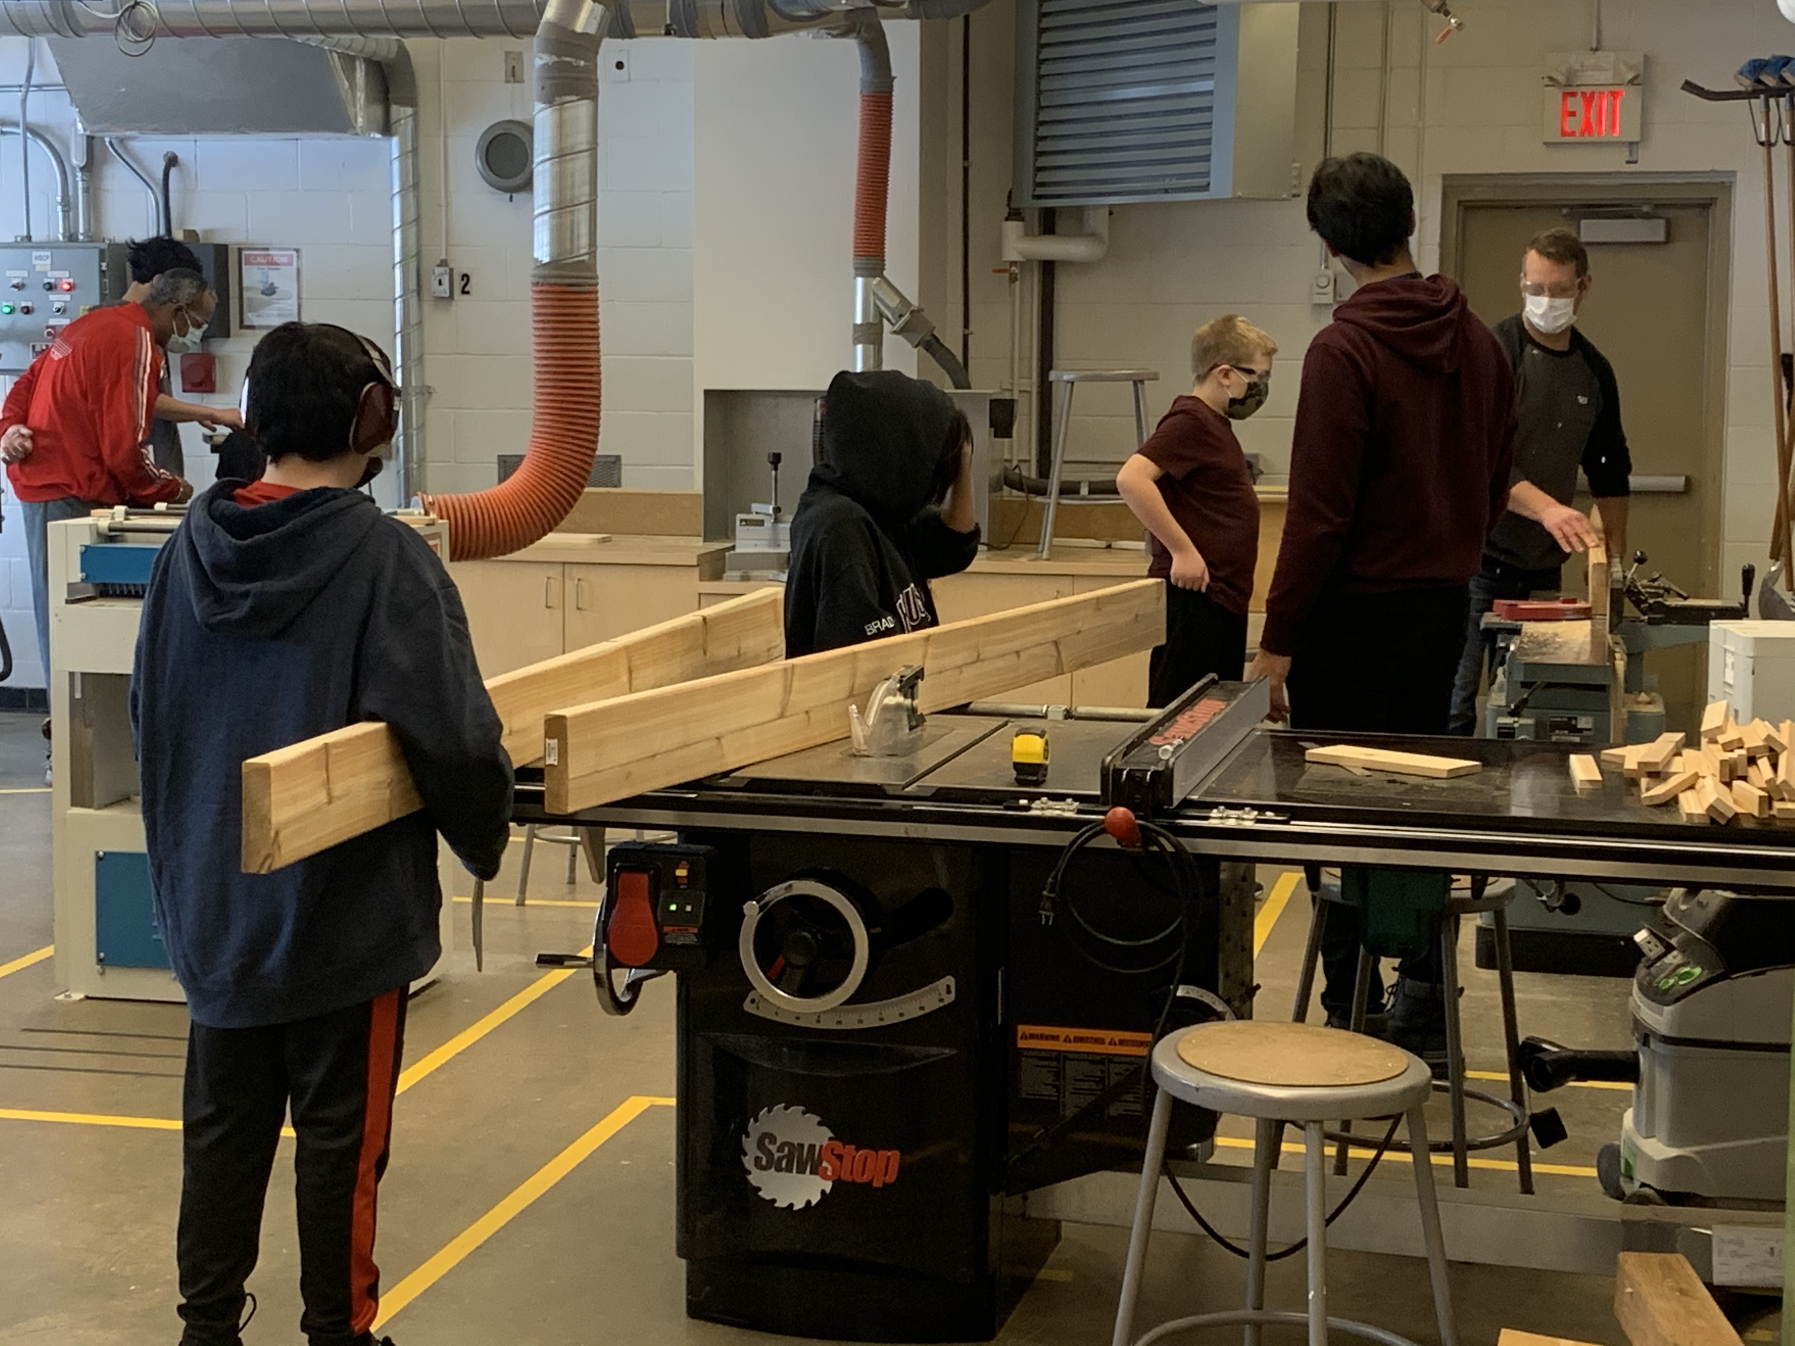
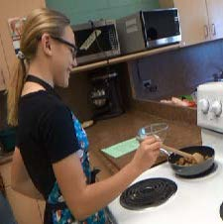
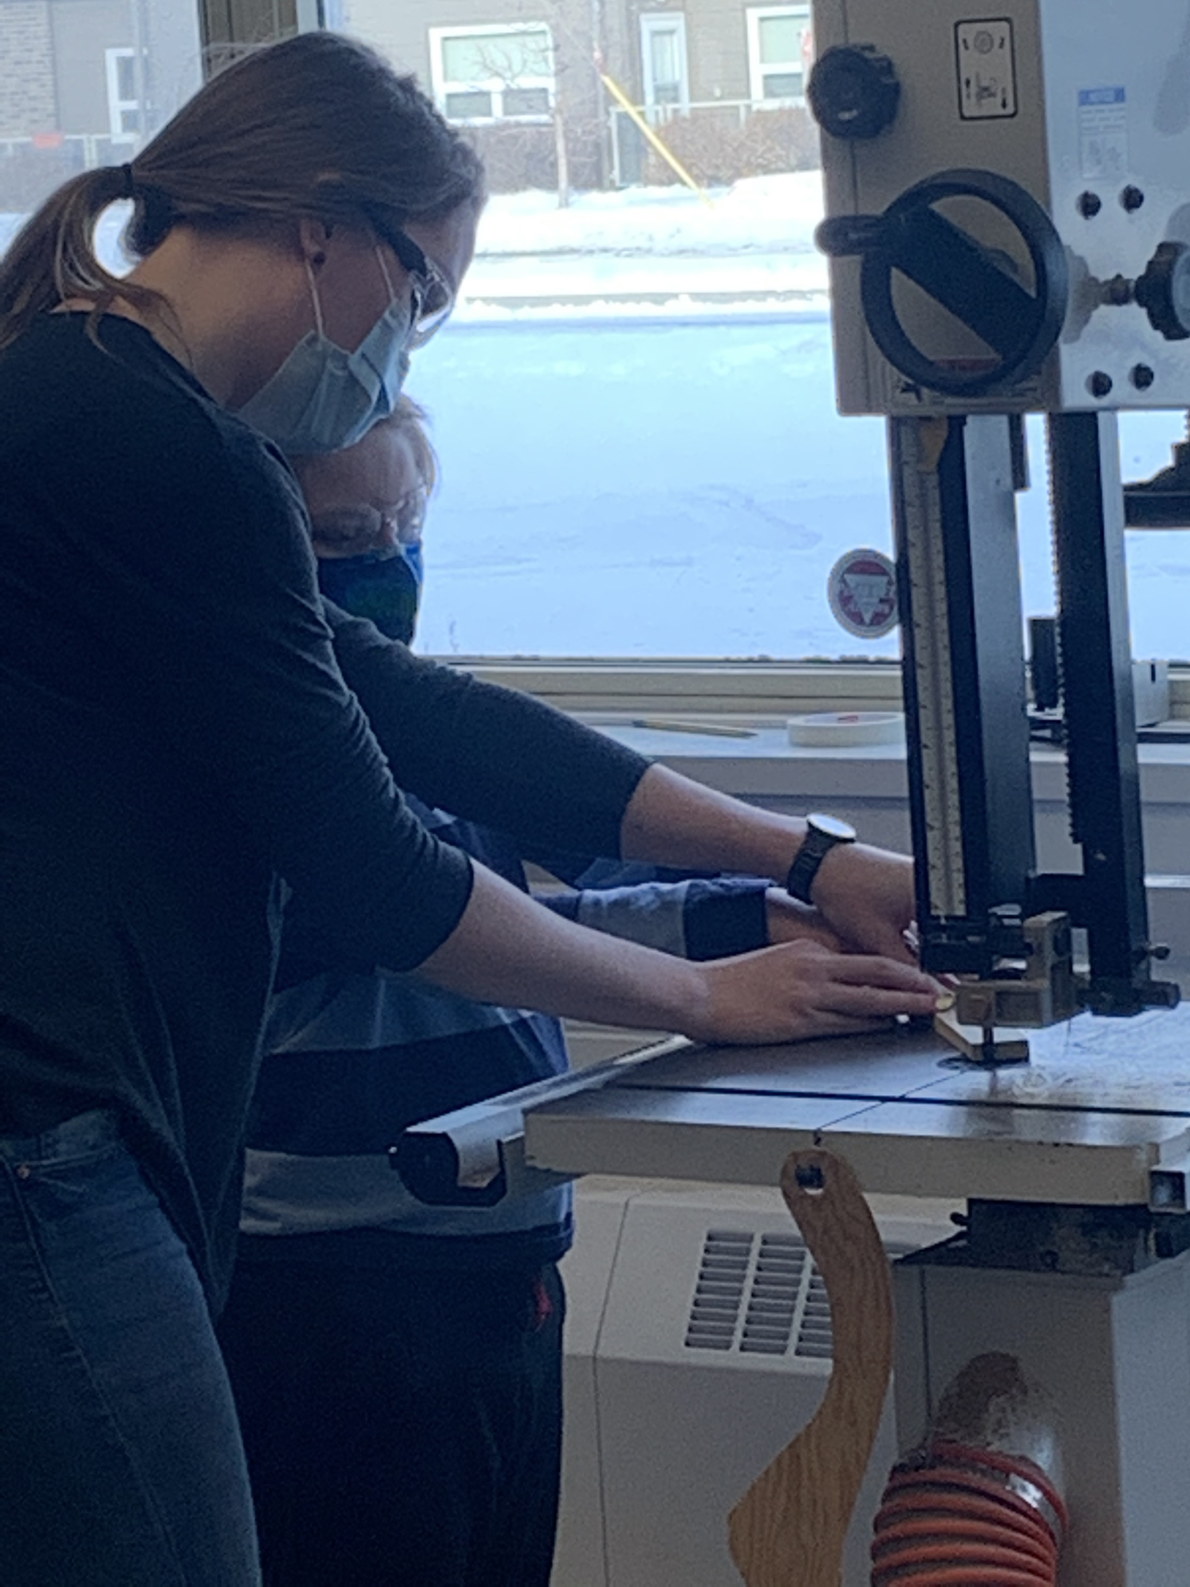
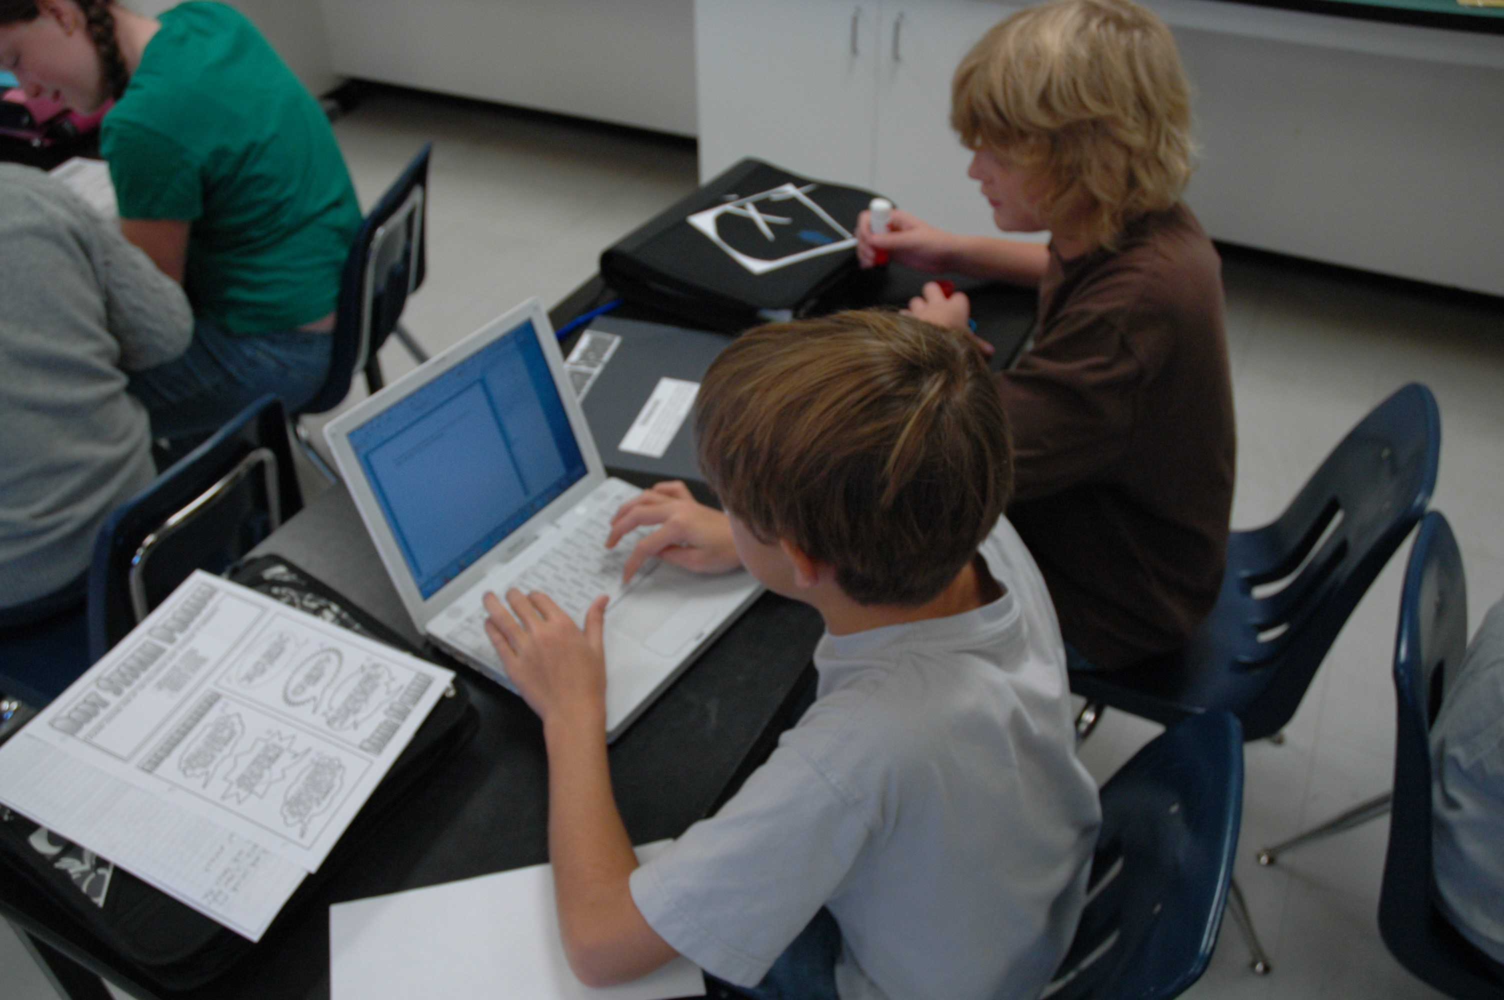
Experiential programming
        Home Economics: Cooking & Sewing
        Woodworking
        Computer Technology:
        Photography
        Stop Motion
        Digital Art &
        Photoshop

Slide 7
Transportation
Students entering grade 6 are eligible for transportation service if the walking distance to their catchment area school exceeds 1.6 km.
The catchment area for Golden Gate is:
North side: Saskatchewan Avenue, South side: Assiniboine River
West side: heading from Moray Street bridge along Portage Avenue to the back lane between Thompson and Nightingale, across Ness Avenue (including Strauss & Thompson Dr. North) to Silver Avenue and then north to Sturgeon Rd.
Our East side: the back lane between Duffield and Sharp Blvd. to Silver Avenue and then northeast to Truro Creek (including Hangar Line, Ottawa Avenue, Canberra Avenue etc.)
Non-residents and non-catchment area students must provide their own transportation to our school.
The opportunity to apply for any bus purchased seats will be
available after September 30, 2021.

Slide 8
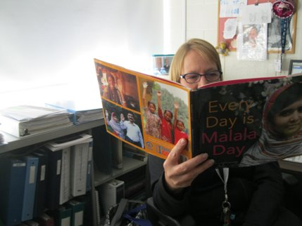

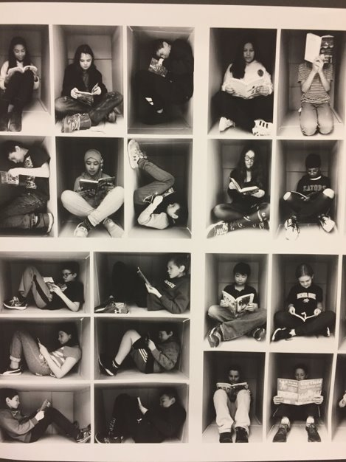
Highlights of Golden Gate Middle School
Every Gator Reads Literacy Program (Daily reading from 12:45-1:02 pm)
Extensive Classroom Homeroom Libraries
Gatoraid
  Teacher Advisory Program
  Focus on Team Building and Wellness Activities
Regular Great Gators Celebration of Success (Celebrating & Recognizing Student Achievement & Citizenship) Assemblies
Intramural Program
ODR at Lunch
Circus Physical Education Program Opportunities
Zones of Regulation & Sources of Strength (Focusing on socio-
emotional well-being)

Slide 9
Extra-curricular Programming
Extra-curricular opportunities offer students the opportunities to develop new skills, new social circles and participate in competitive environments.
We strongly encourage all students to explore ways to get more involved in the culture at our school.
Teams & Clubs meet before and after school or during lunch as appropriate.

Slide 10
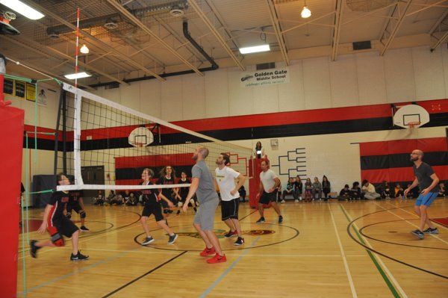
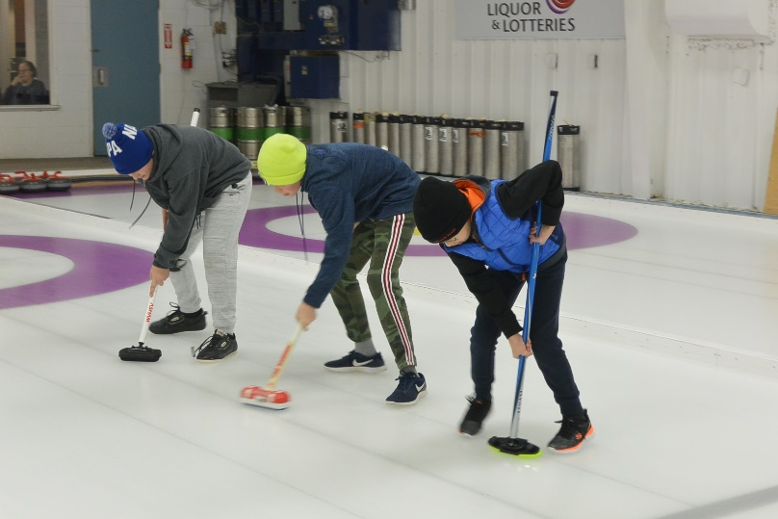
Extra-curricular Athletics
Students can participate in athletic competitions at three different levels-
Atomic, Tier 2 and Tier 1- based on their experience and skill level.
Inter school Programs: Badminton, basketball, cross-country,
track and field, volleyball
Sports Teams/Intramurals;
Cross Country
Volleyball
Basketball
Track & Field
Badminton
Curling
Floor Hockey
ODR

Slide 11
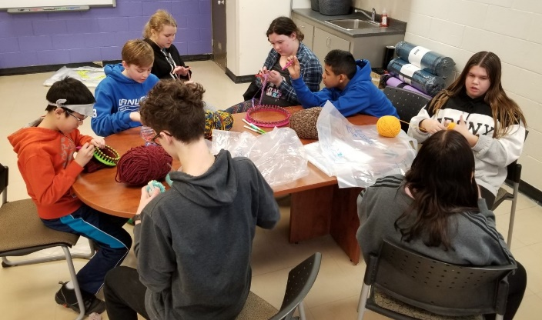
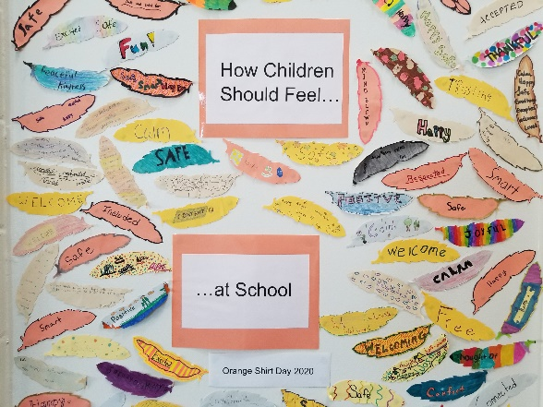
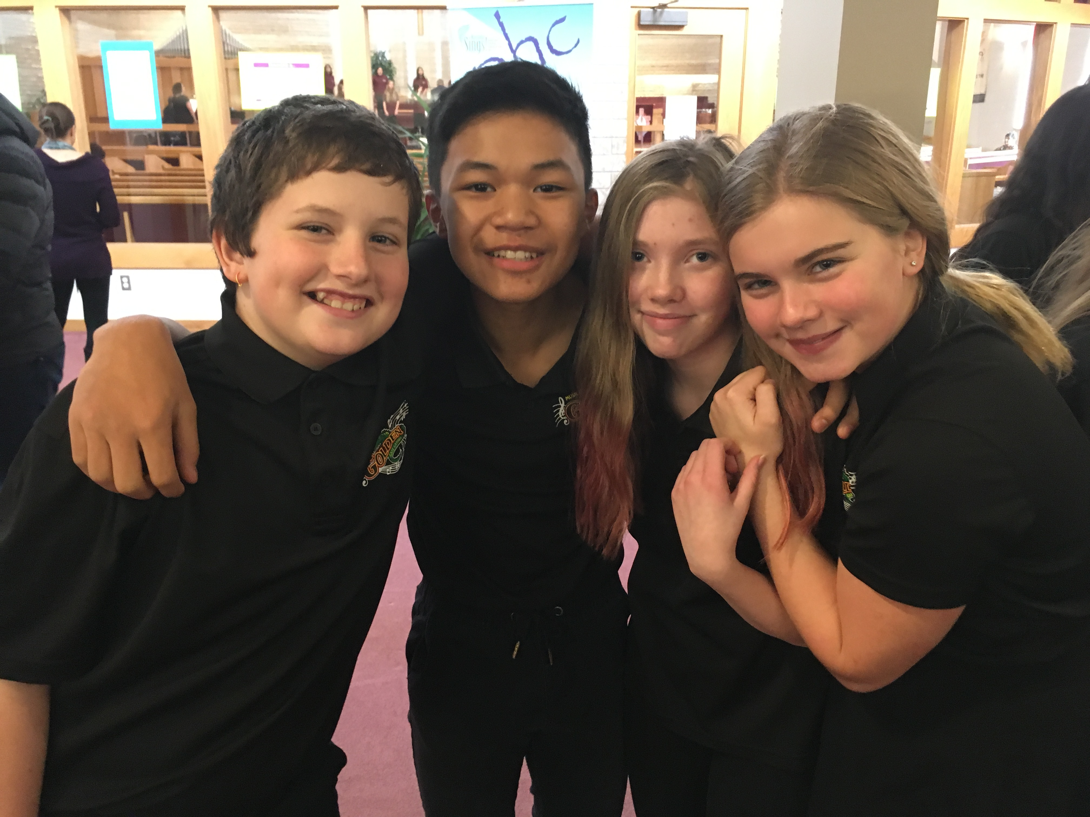
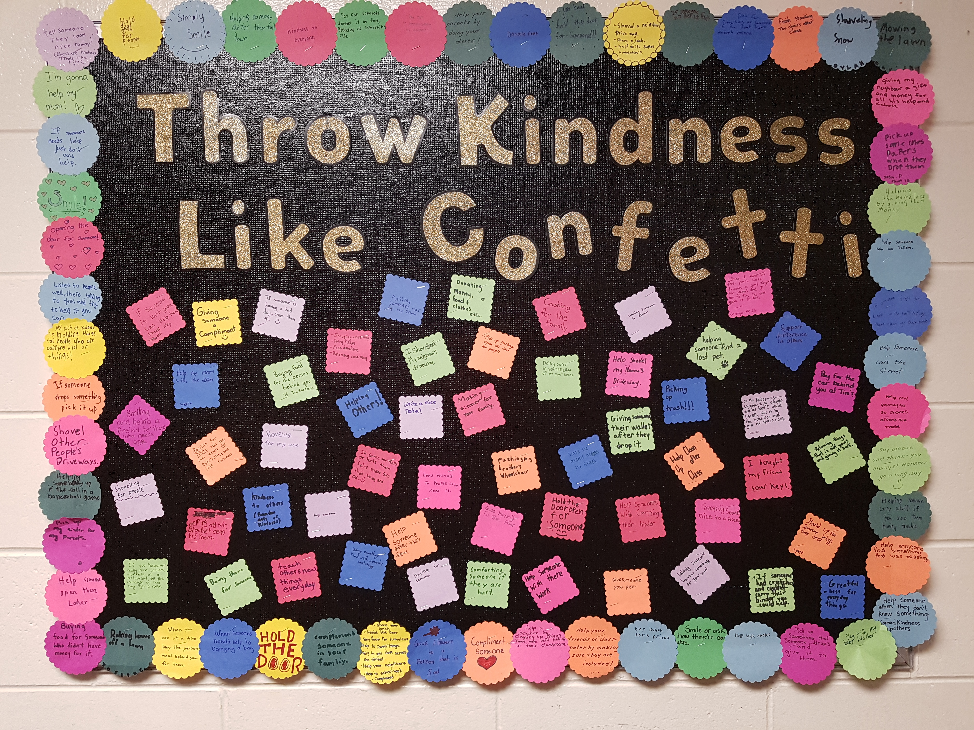
Clubs and Activities
Improv Club
Student Leadership
Computer Club
Art Club
Yarnology
Card Club
Social Justice Club
GSA

Slide 12
Registration
St. James-Assiniboia students that live in the Golden Gate catchment:
Forms will be made available from your elementary school on Friday January 29th, 2021.
These forms should be returned to your current elementary school as soon as possible.
Students outside the St. James-Assiniboia boundary or outside of Golden Gate catchment:
Please log onto the St. James Assiniboia School Division website on Friday February 12th, 2021. There will be a link for you to add your name to the queue requesting what school of choice you are hoping for.

Slide 13
Questions
Please use the link below if you have any questions.
We will be answering all questions and doing an overview of our school at our virtual open house tentatively scheduled for March. More information to come.
Golden Gate Registration Questions

